Slide 1
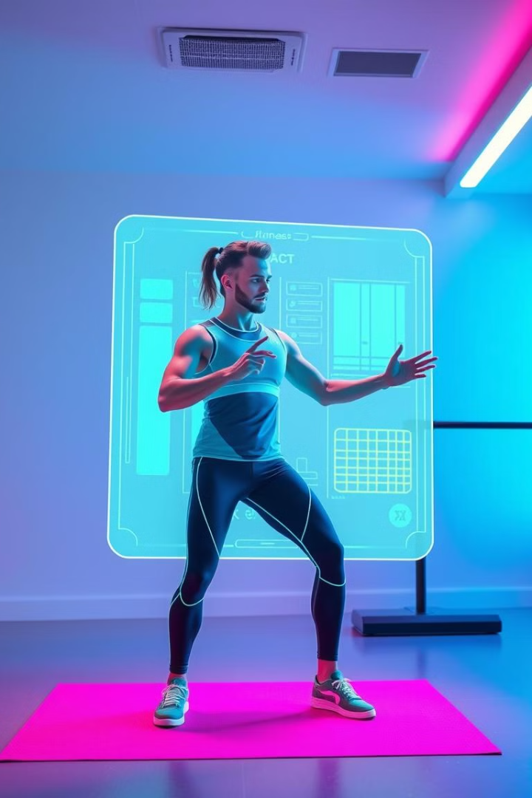
Revolutionizing Fitness: An AI-Powered Personalized Coach
The fitness industry is ripe for disruption with AI. Personalized fitness coaching is currently inaccessible to many. This presentation outlines our solution to democratize personalized fitness through AI.

Slide 2

The Problem: Generic Fitness Plans Fail
Low Adherence
Ineffective Workouts
Information Overload
Cost Barrier
60% of new gym members quit within 3 months.
Generic plans lead to plateaus and injuries.
Conflicting advice overwhelms users.
One-on-one training is unaffordable for many.

Slide 3
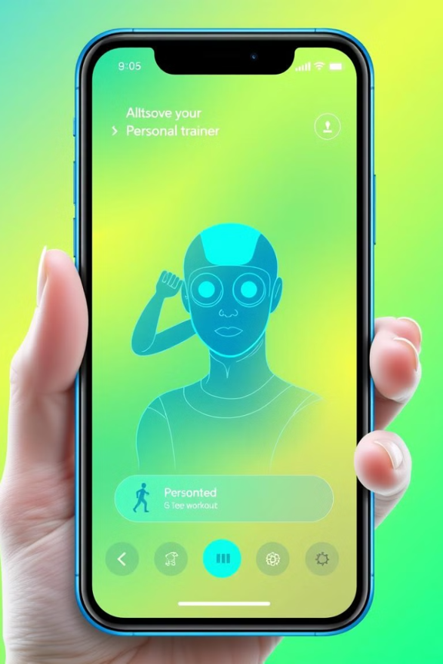
Your Pocket-Sized AI Fitness Guru
1
AI-Driven Personalization
Tailored plans based on individual goals and preferences
2
Real-Time Feedback
AI provides instant feedback on form, minimizing injury risk.
3
Adaptive Training
AI adjusts intensity based on progress, preventing plateaus.
4
Gamified Support
Personalized goals and community features enhance engagement.

Slide 4




Tech Stack & Feasibility: Scalable and Cutting-Edge
TensorFlow/PyTorch for model training.
AWS/Azure for scalable service delivery.
React Native for cross-platform app.

Slide 5
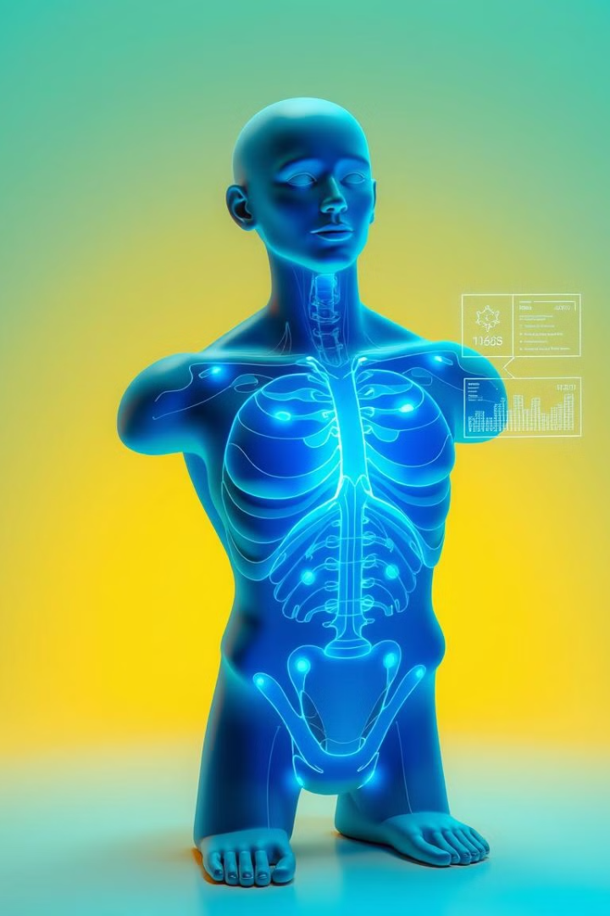



Innovation & Uniqueness: Beyond the Basics
Hyper-Personalization
Analyzes emotional state and sleep.
Predictive Injury Prevention
AI identifies potential injury risks.
Adaptive Nutrition Plans
AI-powered meal planning based on needs.

Slide 6
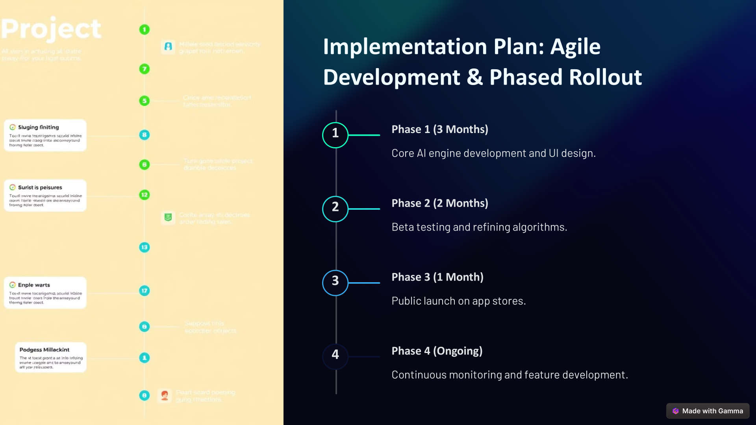
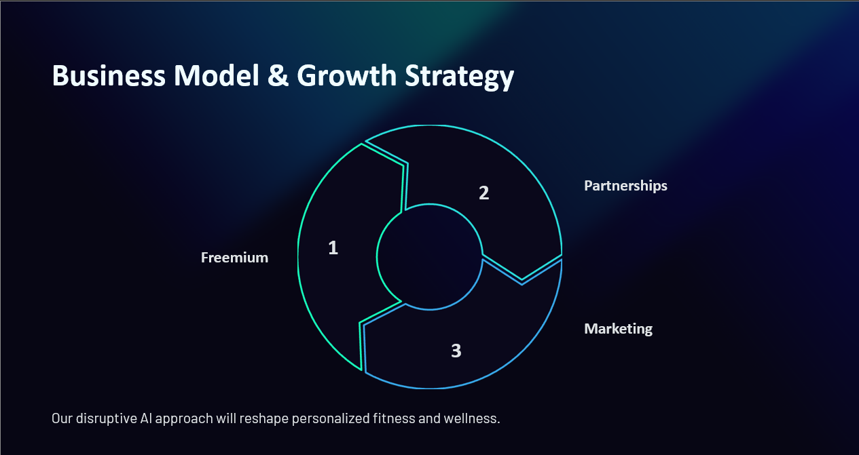


Slide 7
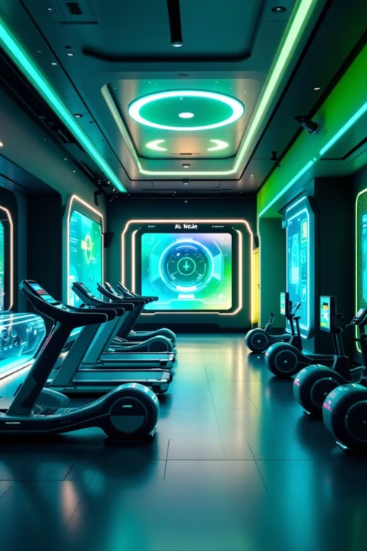
Future Scope & Potential Improvements
The future holds exciting possibilities for AI fitness coaches.
(1) Advanced AI Capabilities : Predictive analysis and emotional AI provide motivation.
(2) Enhanced Data Analysis : Biometric data integration for real-time feedback.
(3) Expansion of Features : Mental health support , telehealth integration , gamification .
(4) Ethical Consideration : Data privacy , transparency , and mitigating bias are key.

Slide 8

Thank You
Our disruptive AI approach will reshape personalized fitness and wellness.

